Slide 1
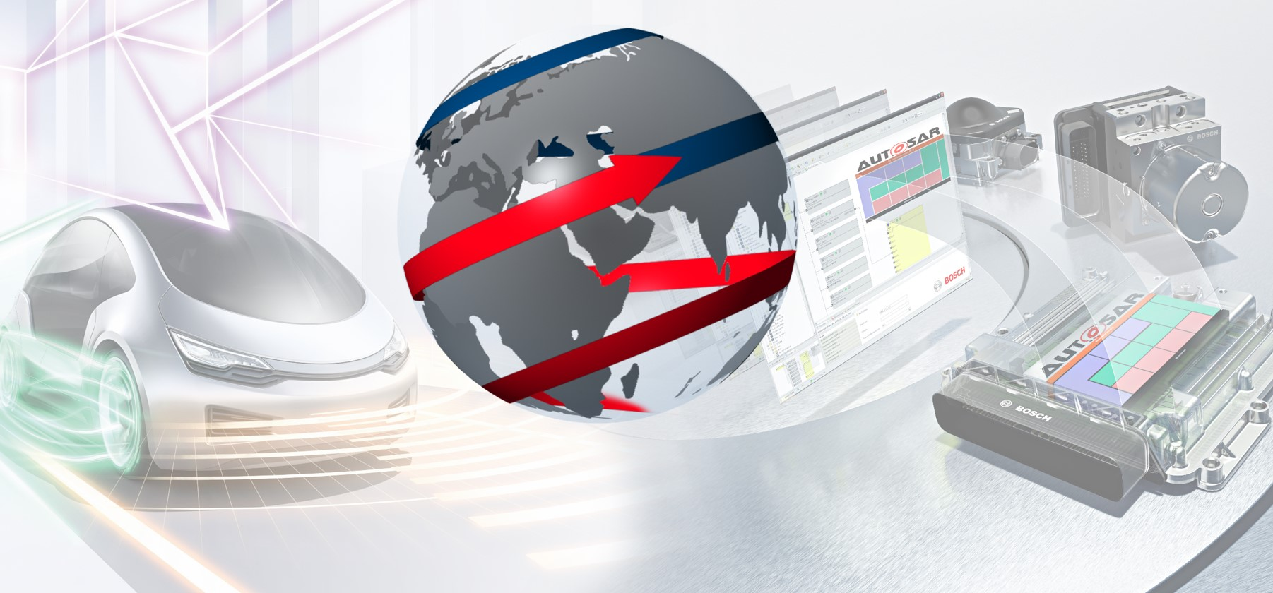

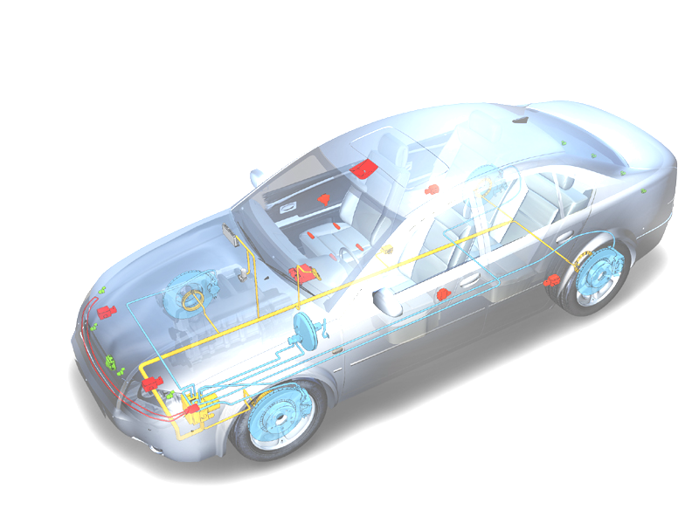
CanTp Training
CanTp Training
CDG-SMT - The Solutions Network -
Confidential | CDG-SMT/ESE3 | 04.10.2016 | © Robert Bosch GmbH 2007. All rights reserved, also regarding any disposal, exploitation, reproduction, editing, distribution, as well as in the event of applications for industrial property rights.

Slide 2
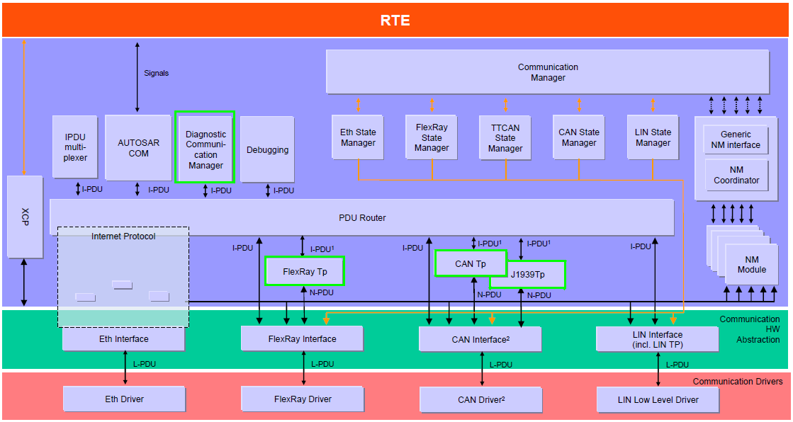
Autosar Communication Stack
CanTp Training
Confidential | CDG-SMT/ESE3 | 04.10.2016 | © Robert Bosch GmbH 2007. All rights reserved, also regarding any disposal, exploitation, reproduction, editing, distribution, as well as in the event of applications for industrial property rights.

Slide 3
Agenda
DCOM CanTp Training
CLASSIC CAN
Introduction to ISO 15765 – Part2
ISO 15765 “Transport Protocol” Features
Introduction to AUTOSAR CanTp
CANFD
Additional AUTOSAR CanTp Features with CanFD
AEEE-Pro
CanTp Configuration Example
Confidential | RBEI/EAR2 - Ramachandran V | 04.10.2016 | © Robert Bosch GmbH 2007. All rights reserved, also regarding any disposal, exploitation, reproduction, editing, distribution, as well as in the event of applications for industrial property rights.

Slide 4
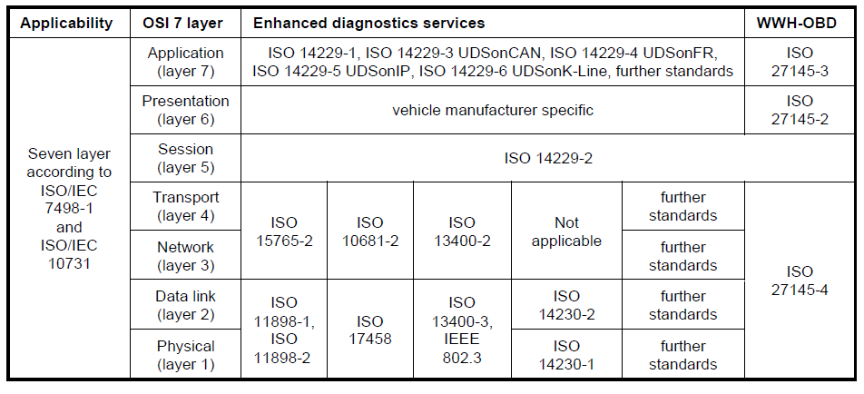
Communication Stack / OSI Layers / ISO Specs
DCOM CanTp Training
Confidential | CDG-SMT/ESB3 Daniel Hahn | 04.10.2016 | © Robert Bosch GmbH 2007. All rights reserved, also regarding any disposal, exploitation, reproduction, editing, distribution, as well as in the event of applications for industrial property rights.

Slide 5
ISO 15765 – Part 2 (Network Layer Services)
DCOM CanTp Training
ISO 15765 – Part 2 specifies an unconfirmed communication protocol tailored to meet the requirements of CAN based diagnostic systems.
ISO/CD 15765 – Part 2 is providing the following services:
Segmentation of data, which do not fit into a single CAN frame, in transmit direction
Reassembling of data in receive direction
Control of data flow
Detection of errors in segmentation sessions
Flexible Data rate support
Confidential | RBEI/EAR2 - Ramachandran V | 04.10.2016 | © Robert Bosch GmbH 2007. All rights reserved, also regarding any disposal, exploitation, reproduction, editing, distribution, as well as in the event of applications for industrial property rights.

Slide 6
Service Primitives defined by ISO 15765-2
DCOM CanTp Training
N_USData.request (Address Information, MessageData, Length)
N_USData.confirm (Address Information, N_Result)
N_USData_FF.indication (Address Information, Length)
N_USData.indication (Address Information, MessageData, Length, N_Result)
N_ChangeParameter.request (Address Information, Parameter, Parameter_Value)
N_ChangeParameter.confirm (Address Information, Parameter, Result_ChangeParameter)
Transport and Network layer as defined by ISO 15765-2
Data Link Layer and Physical Layer
Confidential | CDG-SMT/ESB3 Daniel Hahn | 04.10.2016 | © Robert Bosch GmbH 2007. All rights reserved, also regarding any disposal, exploitation, reproduction, editing, distribution, as well as in the event of applications for industrial property rights.

Slide 7
Service Primitives defined by ISO 15765-2
DCOM CanTp Training
Session Layer and Above
Transport and Network layer as defined by ISO 15765-2
L_Data.confirm ( <Identifier>, <TransferStatus> )
L_Data.request ( <Identifier>, <DLC>, <Data>)
L_Data.indication ( <Identifier>, <DLC>, <Data> )
Confidential | CDG-SMT/ESB3 Daniel Hahn | 04.10.2016 | © Robert Bosch GmbH 2007. All rights reserved, also regarding any disposal, exploitation, reproduction, editing, distribution, as well as in the event of applications for industrial property rights.

Slide 8
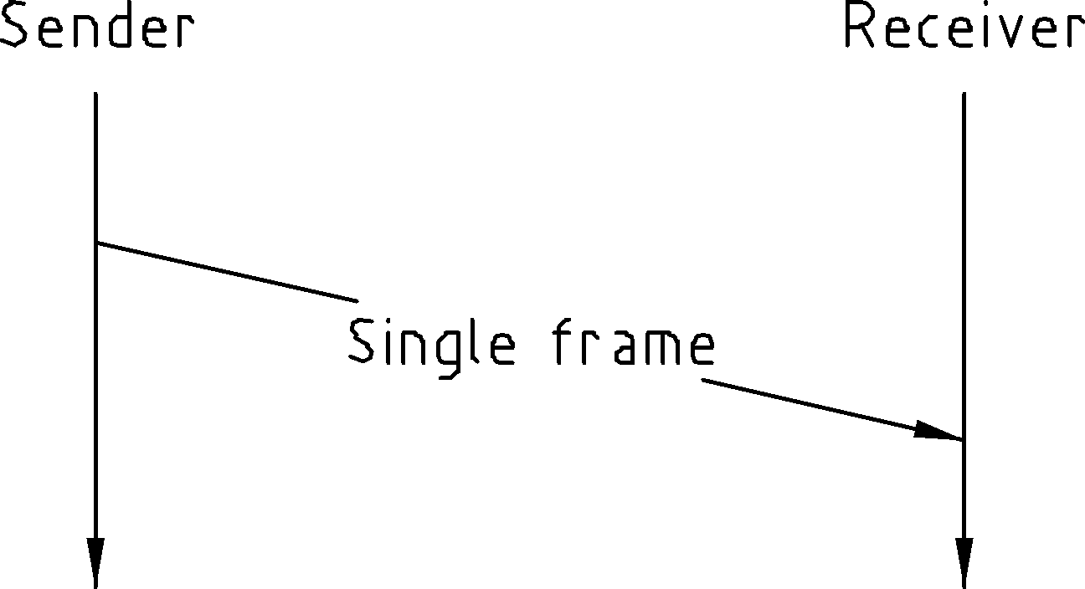
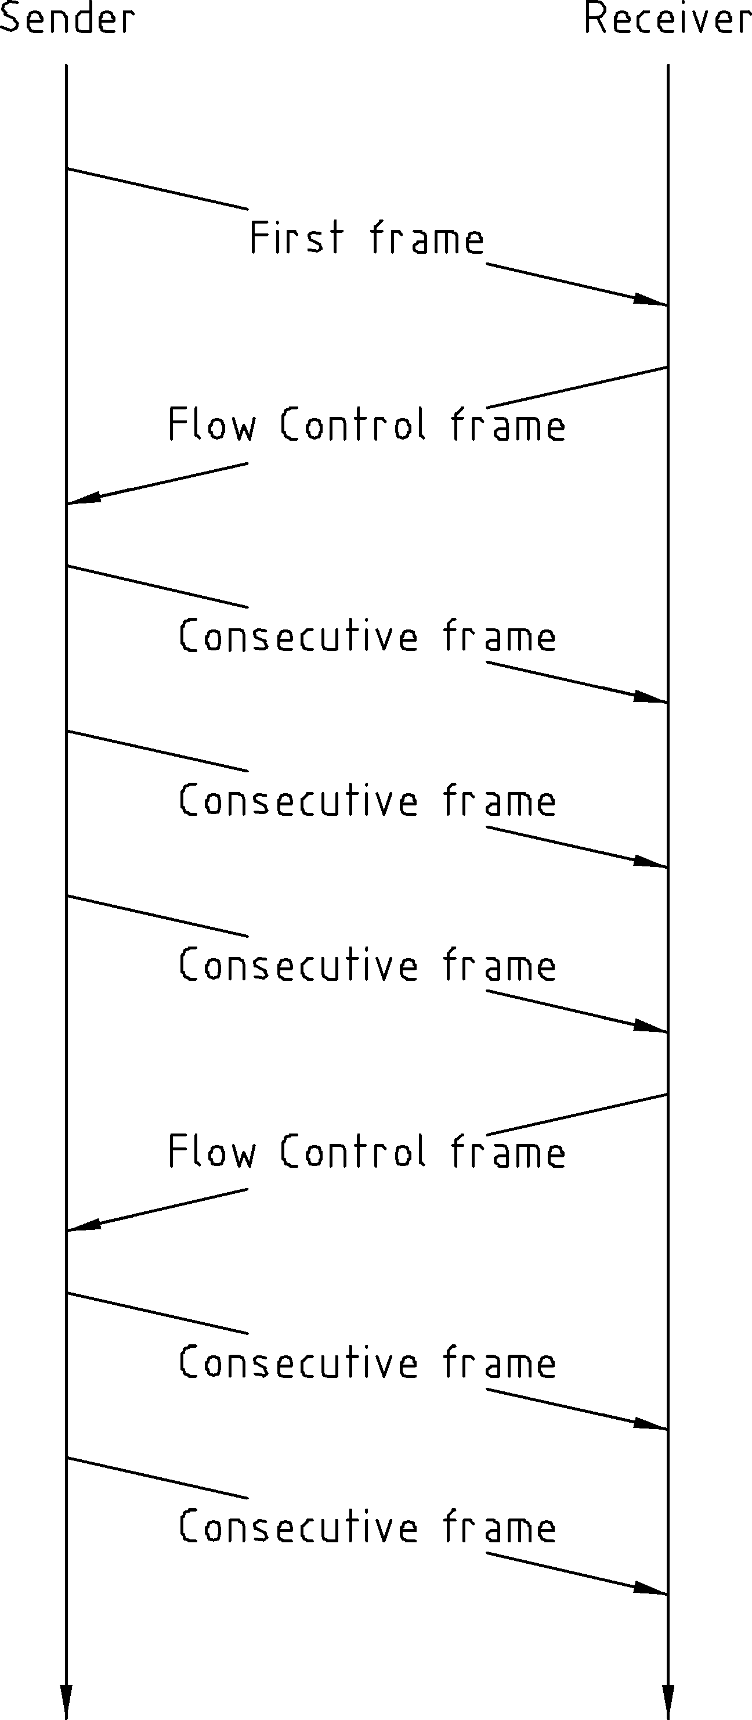
ISO 15765 – Message Transmission
DCOM CanTp Training
Un-Segmented message transmission
Segmented message transmission
Unsegmented Transmission
Single Frame (SF)
Segmented Transmission
Sender starts with First Frame (FF)
Receiver confirms with Flow Control (FC)
Sender sends remaining transmission data with Consecutive Frames (CF)
Confidential | RBEI/EAR2 - Ramachandran V | 04.10.2016 | © Robert Bosch GmbH 2007. All rights reserved, also regarding any disposal, exploitation, reproduction, editing, distribution, as well as in the event of applications for industrial property rights.

Slide 9
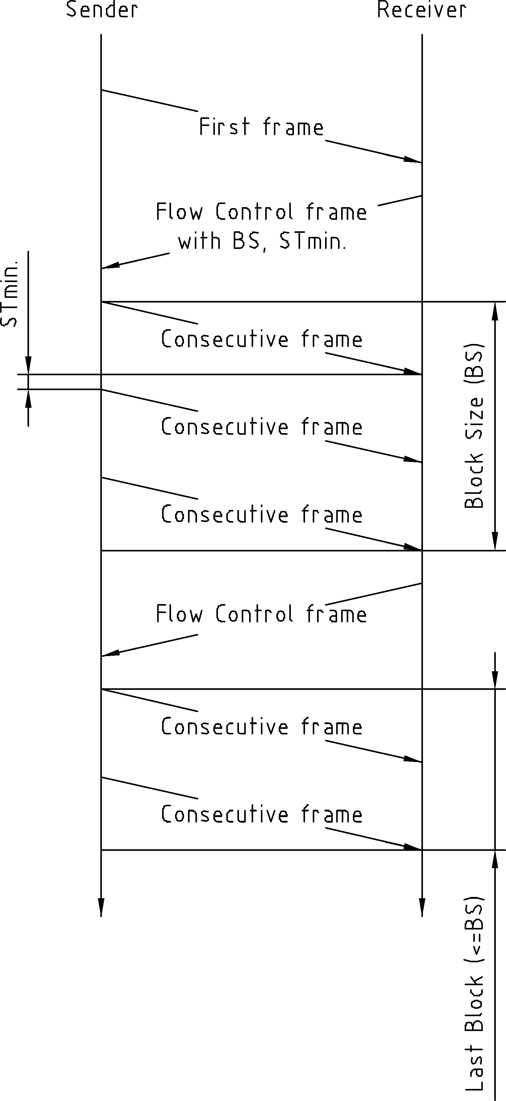
ISO 15765 – STmin, BS
DCOM CanTp Training
Flow Control Parameter
Minimum Separation Time (STmin) Minimum Time the sender shall wait between 2 CFs
Block Size (BS)
Maximum number of CFs the receiver allows the sender to send in one block, before waiting for the next CF. BS = 0 (infinite) All Consecutive Frames (CF) will be send without any further Flow Control frames
Confidential | RBEI/EAR2 - Ramachandran V | 04.10.2016 | © Robert Bosch GmbH 2007. All rights reserved, also regarding any disposal, exploitation, reproduction, editing, distribution, as well as in the event of applications for industrial property rights.

Slide 10
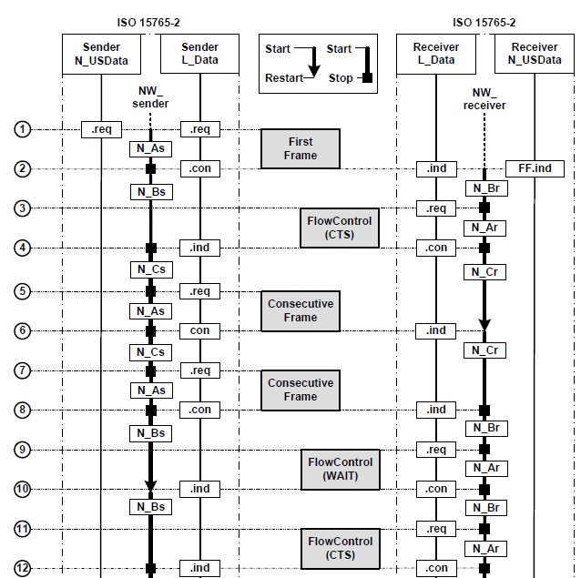
ISO 15765 – Flow Control Status
DCOM CanTp Training
Flow Status
FC.CTS
Request to continue sending the next block of CFs
FC.WAIT
request to wait
FC.OVFLW
Receive buffer overflow.
Confidential | CDG-SMT/ESE3 | 04.10.2016 | © Robert Bosch GmbH 2007. All rights reserved, also regarding any disposal, exploitation, reproduction, editing, distribution, as well as in the event of applications for industrial property rights.

Slide 11
ISO 15765 – Timing-Parameter
DCOM CanTp Training
Timing Parameter
As/Ar Time for transmission of the CAN frame
Bs Time until reception of the next Flow Control Frame
Br Time until transmission of the next Flow Control Frame
Cs Time until transmission of the next Consecutive Frame
Cr Time until reception of the next Consecutive Frame
Confidential | CDG-SMT/ESE3 | 04.10.2016 | © Robert Bosch GmbH 2007. All rights reserved, also regarding any disposal, exploitation, reproduction, editing, distribution, as well as in the event of applications for industrial property rights.

Slide 12
ISO 15765 – CLASSIC CAN - Normal Addressing
DCOM CanTp Training
Frame Type | CAN Identifier | CAN Frame Data field
 |  | Byte 1 |  | Byte 2 | Byte 3 | Byte 4-8
 |  | Bit 7- 4 | Bit 3 – 0
Single Frame (SF) | N_AI | SF = 0x00 | SF_DL | Data
First Frame (FF) | N_AI | FF = 0x01 | FF_DL |  | Data
Consecutive Frame (CF) | N_AI | CF = 0x02 | SN | Data
Flow Control (FC) | N_AI | FC = 0x03 | FS | BS | STmin | N/A
Flow Status
0x00: Clear to Send
0x01: Wait
0x02: Overflow
Legend
SF_DL: 4 Bit Single Frame Data Length FF_DL: 12 Bit First Frame Data Length
SN: Sequence Number FS: Flow Status
BS: Block Size STmin: Minimum Separation Time
PCI - Protocol Control Information
Confidential | RBEI/EAR2 - Ramachandran V | 04.10.2016 | © Robert Bosch GmbH 2007. All rights reserved, also regarding any disposal, exploitation, reproduction, editing, distribution, as well as in the event of applications for industrial property rights.

Slide 13
ISO 15765 – CLASSIC CAN - Extended Addressing
DCOM CanTp Training
Frame Type | CAN Identifier | CAN Frame Data field
 |  | Byte 1 | Byte 2 |  | Byte 3 | Byte 4 | Byte 5-8
 |  |  | Bit 7- 4 | Bit 3 – 0
Single Frame (SF) | N_AI, except N_TA | N_TA | SF = 0x00 | SF_DL | Data
First Frame (FF) | N_AI, except N_TA | N_TA | FF = 0x01 | FF_DL |  | Data
Consecutive Frame (CF) | N_AI, except N_TA | N_TA | CF = 0x02 | SN | Data
Flow Control (FC) | N_AI, except N_TA | N_TA | FC = 0x03 | FS | BS | STmin | N/A
Flow Status
0x00: Clear to Send
0x01: Wait
0x02: Overflow
Legend
SF_DL: 4 Bit Single Frame Data Length FF_DL: 12 Bit First Frame Data Length
SN: Sequence Number FS: Flow Status
BS: Block Size STmin: Minimum Separation Time
TA - Target Address
PCI - Protocol Control Information
Confidential | RBEI/EAR2 - Ramachandran V | 04.10.2016 | © Robert Bosch GmbH 2007. All rights reserved, also regarding any disposal, exploitation, reproduction, editing, distribution, as well as in the event of applications for industrial property rights.

Slide 14
ISO 15765 – CLASSIC CAN - Mixed Addressing
DCOM CanTp Training
Frame Type | CAN Identifier | CAN Frame Data field
 |  | Byte 1 | Byte 2 |  | Byte 3 | Byte 4 | Byte 5-8
 |  |  | Bit 7- 4 | Bit 3 – 0
Single Frame (SF) | N_AI | N_AE | SF = 0x00 | SF_DL | Data
First Frame (FF) | N_AI | N_AE | FF = 0x01 | FF_DL |  | Data
Consecutive Frame (CF) | N_AI | N_AE | CF = 0x02 | SN | Data
Flow Control (FC) | N_AI | N_AE | FC = 0x03 | FS | BS | STmin | N/A
Flow Status
0x00: Clear to Send
0x01: Wait
0x02: Overflow
Legend
SF_DL: 4 Bit Single Frame Data Length FF_DL: 12 Bit First Frame Data Length
SN: Sequence Number FS: Flow Status
BS: Block Size STmin: Minimum Separation Time
TA - Target Address
PCI - Protocol Control Information
Confidential | RBEI/EAR2 - Ramachandran V | 04.10.2016 | © Robert Bosch GmbH 2007. All rights reserved, also regarding any disposal, exploitation, reproduction, editing, distribution, as well as in the event of applications for industrial property rights.

Slide 15
ISO 15765 – Target Address Type
DCOM CanTp Training
Target Address Type
The parameter Target Address Type shall be used to encode the communication model used by the communicating entities.
Communication Models
Two communication models are specified:
Physical addressing (1 to 1 communication) shall be supported for all types of network layer messages.
Functional addressing (1 to n communication, broadcast) shall only be supported for Single Frame communication.
Confidential | RBEI/EAR2 - Ramachandran V | 04.10.2016 | © Robert Bosch GmbH 2007. All rights reserved, also regarding any disposal, exploitation, reproduction, editing, distribution, as well as in the event of applications for industrial property rights.

Slide 16
ISO 15765 – CLASSIC CAN - Padding
DCOM CanTp Training
CAN Frame Data Padding
The DLC (data Length Code) is always set to 8. If the CAN Frame to be transmitted is shorter than 8 bytes, then the sender has to set the DLC to the maximum value 8 (padding of unused data bytes).
In particular this can be the case for a Single Frame, a Flow Control Frame or the last Consecutive Frame of a segmented message.
Confidential | RBEI/EAR2 - Ramachandran V | 04.10.2016 | © Robert Bosch GmbH 2007. All rights reserved, also regarding any disposal, exploitation, reproduction, editing, distribution, as well as in the event of applications for industrial property rights.

Slide 17
ISO 15765 – Half/Full - Duplex
DCOM CanTp Training
Network layer design decision to support full- or half-duplex communication:
Half-duplex: Point-to-point communication between two nodes is only possible in one direction at a time.
Full-duplex: Point-to-point communication between two nodes is possible in both directions at once.
This design decision has a side-effect on the interpretation of “unexpected” frames!
Confidential | CDG-SMT/ESE3 | 04.10.2016 | © Robert Bosch GmbH 2007. All rights reserved, also regarding any disposal, exploitation, reproduction, editing, distribution, as well as in the event of applications for industrial property rights.

Slide 18
Trace – Extended Addressing Request
DCOM CanTp Training
Tester
6FF d 8 11 03 22 10 00 00 00 00 SF
611 d 8 FF 10 14 62 10 00 03 04 FF
Tester Address FF
ECU Address 11
Tester Request 22 10 00
ECU Response 62 10 00 03 04 05 06 07 08 09 0A 0B 0C 0D 0E 0F 10 11 12 13
6FF d 8 11 30 02 05 00 00 00 00 FC
611 d 8 FF 21 05 06 07 08 09 0A CF
ECU
611 d 8 FF 22 0B 0C 0D 0E 0F 10 CF
6FF d 8 11 30 02 05 00 00 00 00 FC
611 d 8 FF 23 11 12 13 00 00 00 CF
Confidential | RBEI/EBA3 Deepak Singh D | 04.10.2016 | © Robert Bosch GmbH 2007. All rights reserved, also regarding any disposal, exploitation, reproduction, editing, distribution, as well as in the event of applications for industrial property rights.

Slide 19
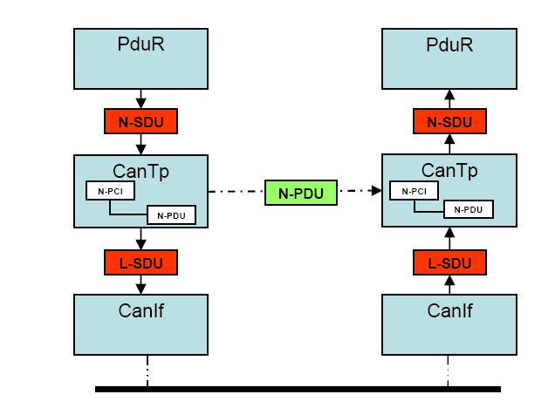
AUTOSAR CanTp - PDUs and SDUs
DCOM CanTp Training
PDU (Protocol Data Unit) In layered systems, it refers to a data unit that is specified in the protocol of a given layer. This contains user data of that layer (SDU) plus possible protocol control information (PCI). Furthermore, the PDU of layer X is the SDU of its lower layer X-1 (i.e. (X)-PDU = (X-1)-SDU).
SDU (Service Data Unit)
In layered systems, this refers to a set of data that is sent by a user of the services of a given layer, and is transmitted to a peer service user.
Confidential | RBEI/EAR2 - Ramachandran V | 04.10.2016 | © Robert Bosch GmbH 2007. All rights reserved, also regarding any disposal, exploitation, reproduction, editing, distribution, as well as in the event of applications for industrial property rights.

Slide 20
AUTOSAR CanTp - Interfaces to/with CAN-IF
DCOM CanTp Training
Std_ReturnType CanIf_Transmit ( PduIdType CanTxPduId, const PduInfoType* PduInfoPtr )
This service initiates a request for transmission of the CAN L-PDU specified by the CanTxPduId and CAN related data in the L-PDU structure.
void CanTp_RxIndication ( PduIdType RxPduId, PduInfoType* PduInfoPtr )
This function is called by the CAN Interface after a successful reception of a Rx CAN L-PDU which is configured in CanIf/Can for CanTp.
void CanTp_TxConfirmation (PduIdType CanTpTxPduId)
The main function for scheduling the CAN TP (Entry point for scheduling).
Confidential | RBEI/EAR2 - Ramachandran V | 04.10.2016 | © Robert Bosch GmbH 2007. All rights reserved, also regarding any disposal, exploitation, reproduction, editing, distribution, as well as in the event of applications for industrial property rights.

Slide 21
AUTOSAR CanTp - Interfaces to/with PduR (Rx)
DCOM CanTp Training
BufReq_ReturnType PduR_CanTpStartOfReception
( PduIdType id, PduLengthType TpSduLength, PduLengthType* bufferSizePtr )
This function is called by the CANTP to indicate PduR about a start of new reception (i.e. SF or FF is received in CanTp)
BufReq_ReturnType PduR_CanTpCopyRxData
( PduIdType id, PduInfoType* info, PduLengthType* bufferSizePtr )
This function is called when a transport protocol module has data to copy for the receiving module.
void PduR_CanTpRxIndication
( PduIdType CanTpRxPduId, NotifResultType Result )
This function is called by the CAN TP after successful/unsuccessful reception of data.
Confidential | RBEI/EAR2 - Ramachandran V | 04.10.2016 | © Robert Bosch GmbH 2007. All rights reserved, also regarding any disposal, exploitation, reproduction, editing, distribution, as well as in the event of applications for industrial property rights.

Slide 22
AUTOSAR CanTp - Interfaces to/with PduR (Tx)
DCOM CanTp Training
Std_ReturnType CanTp_Transmit
(PduIdType CanTpTxSduId,const PduInfoType* CanTpTxInfoPtr)
This service is used to request the transfer of (un)segmented data.
BufReq_ReturnType PduR_CanTpCopyTxData
( PduIdType id, PduInfoType* info, RetryInfoType* retry, PduLengthType* availableDataPtr )
This function is called by the transport protocol module to query the transmit data of an I-PDU segment. PduR shall need to copy the required data to transmit (SF, FF or CF) accordingly to CanTp Buffer which is provided along with this call-back.
void PduR_CanTpTxConfirmation ( PduIdType CanTpTxPduId, NotifResultType Result )
This function is called by the CAN Transport Protocol after successful/unsuccesful transmision of a transmit request
Confidential | RBEI/EAR2 - Ramachandran V | 04.10.2016 | © Robert Bosch GmbH 2007. All rights reserved, also regarding any disposal, exploitation, reproduction, editing, distribution, as well as in the event of applications for industrial property rights.

Slide 23
AUTOSAR CanTp - Interfaces to Scheduler
DCOM CanTp Training
void CanTp_Init ( const CanTp_ConfigType* CfgPtr )
This API is responsible for initialisation of CanTp
void CanTp_Shutdown ( void )
This API is responsible to close all the active Channels/Connections of CanTp and move CanTp to shutdown state.
void CanTp_MainFunction ( void )
This API is the main function which has to be called from a fixed cyclic process by the OS Scheduler.
void CanTp_GetVersionInfo ( Std_VersionInfoType* versioninfo )
This API can be used by any component to check or validate the version compatibility of CanTp with the other dependant components.
Confidential | RBEI/EAR2 - Ramachandran V | 04.10.2016 | © Robert Bosch GmbH 2007. All rights reserved, also regarding any disposal, exploitation, reproduction, editing, distribution, as well as in the event of applications for industrial property rights.

Slide 24
AUTOSAR CanTp - Br / Cs - Timeout
DCOM CanTp Training
CanTp166: At the reception of a FF, last CF of a block or a SF, the CanTp module shall start a time-out N_Br before requesting an Rx buffer
CanTp167:
After a transmission request from upper layer, the CanTp module shall start time-out N_Cs before the call of PduR_CanTpCopyTxData. If a buffer is not available before the timer elapsed, the CanTp module shall abort the communication.
N_Br and N_Cs are defined as “performance parameters in ISO15765” but
AUTOSAR CanTp is “redefining” N_Br and N_Cs as timeout parameter for
buffer handling with PduR !
Confidential | RBEI/EAR2 - Ramachandran V | 04.10.2016 | © Robert Bosch GmbH 2007. All rights reserved, also regarding any disposal, exploitation, reproduction, editing, distribution, as well as in the event of applications for industrial property rights.

Slide 25

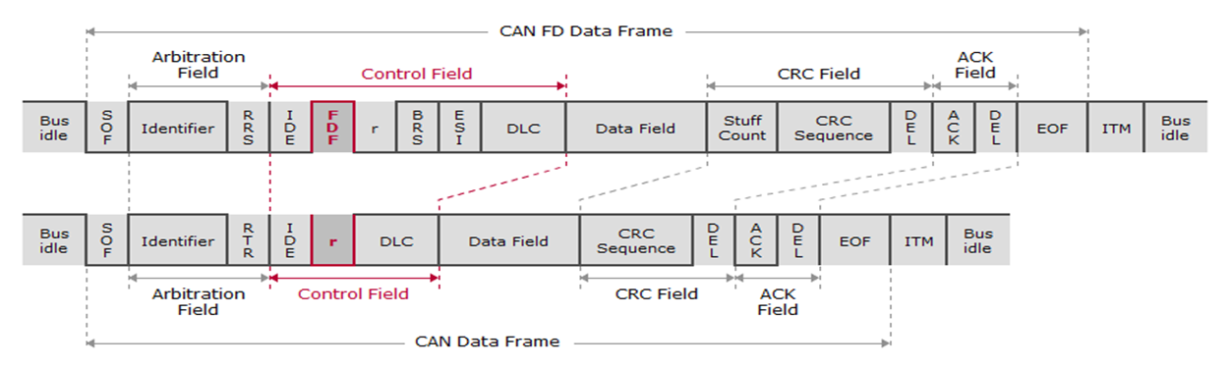
Switch from Can To CanFD [Flexible Data Rate]
DCOM CanTp Training
CAN FD
Switch from CAN to CAN FD
The reserve bit of the traditional CAN frame now becomes the switch for the CAN FD format. If transferred dominant as 0, it denotes a classical CAN frame. If it contains the recessive value 1, it denotes a CAN FD frame.
The bit's new name is FDF for Flexible Data Rate Format which establishes the opportunity to transmit a much larger payload. The actual length of the data field and the decision whether to switch to a higher transmission rate or not, follow later in the frame.
Confidential | CDG-SMT/ESB3 Daniel Hahn | 04.10.2016 | © Robert Bosch GmbH 2007. All rights reserved, also regarding any disposal, exploitation, reproduction, editing, distribution, as well as in the event of applications for industrial property rights.

Slide 26

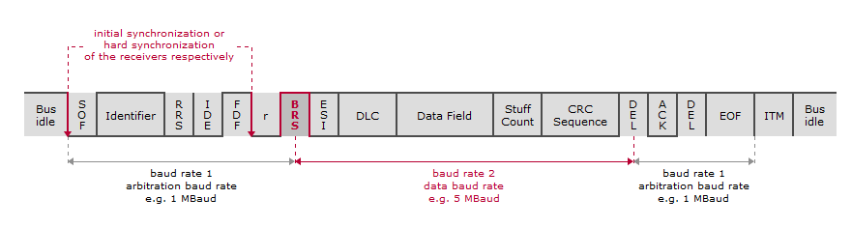
Can with Flexible Data Rate in Data Field
DCOM CanTp Training
CAN FD
Bit Rate Switch
After a reserve bit r0 for future extensions to CAN FD a bit called Bit Rate Switch (BRS) follows. When BRS is dominant, baud rate 2 is equal to baud rate 1, so no accelerated transmission will occur.
If BRS is recessive, the part of the CAN FD frame marked red in the graphic, will be transmitted at the higher baud rate 2. For all CAN FD controllers on one bus both transmission rates have to be configured uniformly.
For more information regarding Flexible data rate feature in Can Controller please refer below training slides.
http://www.bosch-semiconductors.de/media/pdf_1/canliteratur/can_fd_spec.pdf
Confidential | CDG-SMT/ESB3 Daniel Hahn | 04.10.2016 | © Robert Bosch GmbH 2007. All rights reserved, also regarding any disposal, exploitation, reproduction, editing, distribution, as well as in the event of applications for industrial property rights.

Slide 27
CanTp with Flexible Data Rate Support
DCOM CanTp Training
Up to 64 Bytes payload A CAN FD (Flexible Data Rate) protocol device can transmit/receive frames with payload sizes from 1 to 64 bytes. A CAN FD protocol device is also capable of transmitting/receiving CLASSIC CAN frames.
Up to 4GB Bytes messages Using CanFD the maximum segmented message length supported is equal to 4294967295(4GB) bytes of user data, but currently CUBAS CANTP is supporting only 64K bytes of user data.
Mandatory Padding For N_PDU length values up to 8 bytes either the data padding or the DLC data optimization are applicable. To prevent the transmission of uninitialized data the padding of CAN frame data is mandatory for DLC values greater than eight ,when the length of the N_PDU size to be transmitted is not equal to one of the discrete length values defined in the ISO 11898-1:2014 DLC table.
Backwards Compatibility An Optional parameter CanTpFlexibleDataRateSupport is provided to support this feature in CanTp. This parameter is defined by AR4.2.x.
Confidential | CDG-SMT/ESB3 Daniel Hahn | 04.10.2016 | © Robert Bosch GmbH 2007. All rights reserved, also regarding any disposal, exploitation, reproduction, editing, distribution, as well as in the event of applications for industrial property rights.

Slide 28
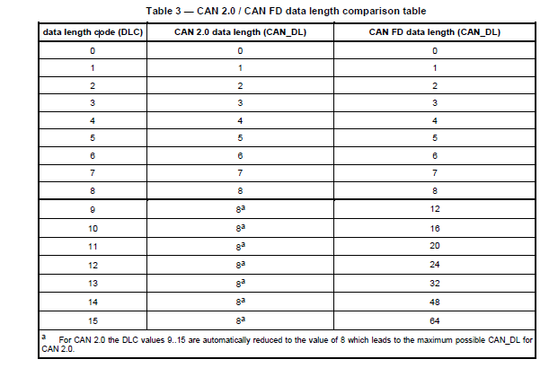
CAN 2.0 / CAN FD Data length comparison table
DCOM CanTp Training
Confidential | CDG-SMT/ESB3 Daniel Hahn | 04.10.2016 | © Robert Bosch GmbH 2007. All rights reserved, also regarding any disposal, exploitation, reproduction, editing, distribution, as well as in the event of applications for industrial property rights.

Slide 29
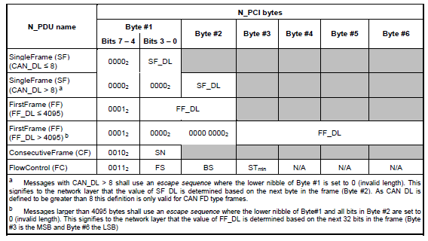
CAN 2.0 / CAN FD Frame Format comparison
DCOM CanTp Training
Confidential | CDG-SMT/ESB3 Daniel Hahn | 04.10.2016 | © Robert Bosch GmbH 2007. All rights reserved, also regarding any disposal, exploitation, reproduction, editing, distribution, as well as in the event of applications for industrial property rights.

Slide 30
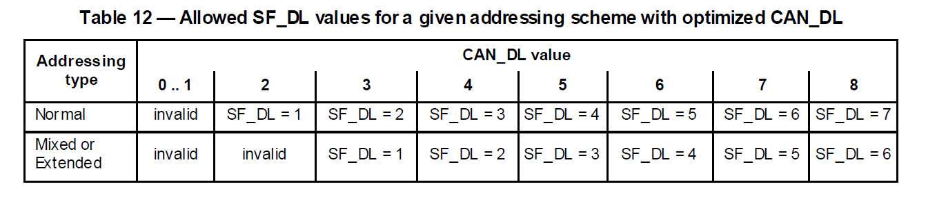
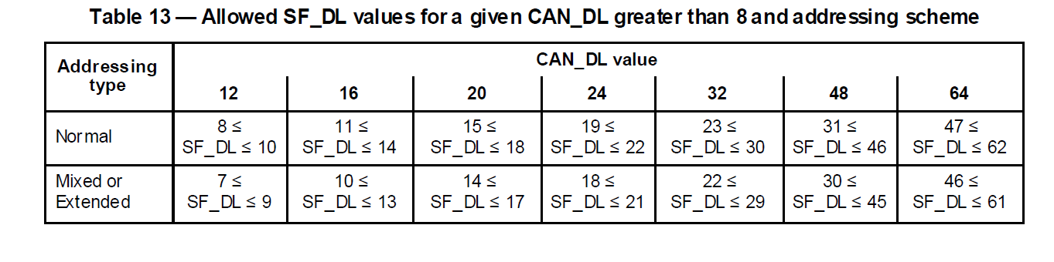
CAN 2.0 / CAN FD: SF_DL versus CAN_DL
DCOM CanTp Training
Confidential | CDG-SMT/ESB3 Daniel Hahn | 04.10.2016 | © Robert Bosch GmbH 2007. All rights reserved, also regarding any disposal, exploitation, reproduction, editing, distribution, as well as in the event of applications for industrial property rights.

Slide 31
ISO/CD 15765-2 – Normal Addressing in CanFD
DCOM CanTp Training
Frame Type | CAN Identifier | CAN Frame Data field
 |  | Byte 1 |  | Byte 2 | Byte 3 | Byte 4-6 | Byte 7-64
 |  | Bit 7- 4 | Bit 3 – 0
Single Frame (SF) | N_AI | SF = 0x00 | 0x00 | SF_DL | Data
First Frame (FF) | N_AI | FF = 0x01 | 0x00 |  | FF_DL |  | Data
Consecutive Frame (CF) | N_AI | CF = 0x02 | SN | Data
Flow Control (FC) | N_AI | FC = 0x03 | FS | BS | STmin | N/A
Messages with CAN_DL > 8 can use an escape sequence where the lower nibble of Byte #1 is set to 0 (invalid length). This signifies to the network layer that the value of SF_DL is determined based on the next byte in the frame (Byte #2). As CAN_DL is defined to be greater than 8 this definition is only valid for CAN FD type frames.
Messages larger than 4095 bytes shall use an escape sequence where the lower nibble of Byte#1 and all bits in Byte #2 are set to 0 (invalid length). This signifies to the network layer that the value of FF_DL is determined based on the next 32 bits in the frame (Byte #3 is the MSB and Byte #6 the LSB)
PCI - Protocol Control Information
Confidential | CDG-SMT/ESB3 Daniel Hahn | 04.10.2016 | © Robert Bosch GmbH 2007. All rights reserved, also regarding any disposal, exploitation, reproduction, editing, distribution, as well as in the event of applications for industrial property rights.

Slide 32
ISO/CD 15765-2– Extended Addressing in CanFD
DCOM CanTp Training
Frame Type | CAN Identifier | CAN Frame Data field
 |  | Byte 1 | Byte 2 |  | Byte 3 | Byte 4 | Byte 5-7 | Byte 8-64
 |  |  | Bit 7- 4 | Bit 3 – 0
Single Frame (SF) | N_AI, except N_TA | N_TA | SF = 0x00 | 0x00 | SF_DL | Data
First Frame (FF) | N_AI, except N_TA | N_TA | FF = 0x01 | 0x00 |  | FF_DL |  | Data
Consecutive Frame (CF) | N_AI, except N_TA | N_TA | CF = 0x02 | SN | Data
Flow Control (FC) | N_AI, except N_TA | N_TA | FC = 0x03 | FS | BS | STmin | N/A
Flow Status
0x00: Clear to Send
0x01: Wait
0x02: Overflow
Legend
SF_DL: 8 Bit Single Frame Data Length FF_DL: 32 Bit First Frame Data Length
SN: Sequence Number FS: Flow Status
BS: Block Size STmin: Minimum Separation Time
TA - Target Address
PCI - Protocol Control Information
Confidential | CDG-SMT/ESB3 Daniel Hahn | 04.10.2016 | © Robert Bosch GmbH 2007. All rights reserved, also regarding any disposal, exploitation, reproduction, editing, distribution, as well as in the event of applications for industrial property rights.

Slide 33
ISO/CD 15765-2– Mixed Addressing in CanFD
DCOM CanTp Training
Frame Type | CAN Identifier | CAN Frame Data field
 |  | Byte 1 | Byte 2 |  | Byte 3 | Byte 4 | Byte 5-7 | Byte 8-64
 |  |  | Bit 7- 4 | Bit 3 – 0
Single Frame (SF) | N_AI | N_AE | SF = 0x00 | 0x00 | SF_DL | Data
First Frame (FF) | N_AI | N_AE | FF = 0x01 | 0x00 |  | FF_DL |  | Data
Consecutive Frame (CF) | N_AI | N_AE | CF = 0x02 | SN | Data
Flow Control (FC) | N_AI | N_AE | FC = 0x03 | FS | BS | STmin | N/A
Flow Status
0Clear to Send
0x01: Wait
0x02: Overflow
x00:
Legend
SF_DL: 8 Bit Single Frame Data Length FF_DL: 32 Bit First Frame Data Length
SN: Sequence Number FS: Flow Status
BS: Block Size STmin: Minimum Separation Time
TA - Target Address
PCI - Protocol Control Information
Confidential | RBEI/EAR2 - Ramachandran V | 04.10.2016 | © Robert Bosch GmbH 2007. All rights reserved, also regarding any disposal, exploitation, reproduction, editing, distribution, as well as in the event of applications for industrial property rights.

Slide 34
Extended Addressing Request for CanFD
DCOM CanTp Training
with escape sequence
6FF d 9 11 00 07 22 10 00 xx xx xx xx 00 00 SF
Tester
Tester Request (7 Bytes) 22 10 00 xx xx xx xx
ECU Response (39 Bytes) 62 10 00 03 04 05 06 07 08 09 0A 0B 0C 0D 0E 0F 10 11 12 13 14 15 16 17 18 19 20 21 22 23 24 25 26 27 28 29 30 31 32
Constraints
CAN_DL = 12
without escape sequence
611 d 9 FF 10 27 62 10 00 03 04 05 06 07 08 FF
6FF d 9 11 30 02 05 00 00 00 00 00 00 00 00 FC
611 d 9 FF 21 09 0A 0B 0C 0D 0E 0F 10 11 12 CF
ECU
611 d 9 FF 22 13 14 15 16 17 18 19 20 21 22 CF
6FF d 9 11 30 02 05 00 00 00 00 00 00 00 00 FC
611 d 9 FF 23 23 24 25 26 27 28 29 30 31 32 CF
Confidential | RBEI/EBA3 Deepak Singh D | 04.10.2016 | © Robert Bosch GmbH 2007. All rights reserved, also regarding any disposal, exploitation, reproduction, editing, distribution, as well as in the event of applications for industrial property rights.

Slide 35
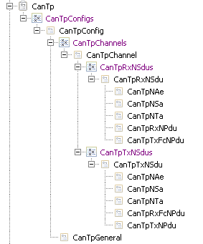
CanTp Configuration Container View (BCT)
DCOM CanTp Training
Top level Config
Channels within CanTp
Rx Connections
Extended/Mixed Addressing Info
Tx Connections
CanTp General
Pdu references to CanIf
Confidential | CDG-SMT/ESB3 Daniel Hahn | 04.10.2016 | © Robert Bosch GmbH 2007. All rights reserved, also regarding any disposal, exploitation, reproduction, editing, distribution, as well as in the event of applications for industrial property rights.

Slide 36
CanTp – Channels
DCOM CanTp Training
Each Rx/Tx Connection (Tx-N-SDU/Rx-N-SDU) is statically linked to one connection channel. Sharing of Rx Connection or Tx Connection across Channels is basically not allowed.
Each instance of CanTp Channel is an independent entity. This means that a CanTp channel uses its own resources, such as internal buffer, timer, or state machine.
If a CanTp Channel is assigned to multiple connections, then resources are shared between different connections, and the CAN Transport Layer will reject transmission or abort receiving, if no free connection channels are available.
Half-Duplex: Only one connection (including all the Rx and Tx) can be active within a Channel at any given point of time.
Full-Duplex: Only one Rx connection and one Tx Connection can be active within a Channel at any given point of time. Other Rx and Tx connections would have to wait until the existing connections complete the usage of channel.
Channel 1
Rx Connection 1
Rx Connection 2
Tx Connection 1
Channel 2
Rx Connection 3
Tx Connection 2
Confidential | RBEI/EAR2 - Ramachandran V | 04.10.2016 | © Robert Bosch GmbH 2007. All rights reserved, also regarding any disposal, exploitation, reproduction, editing, distribution, as well as in the event of applications for industrial property rights.

Slide 37
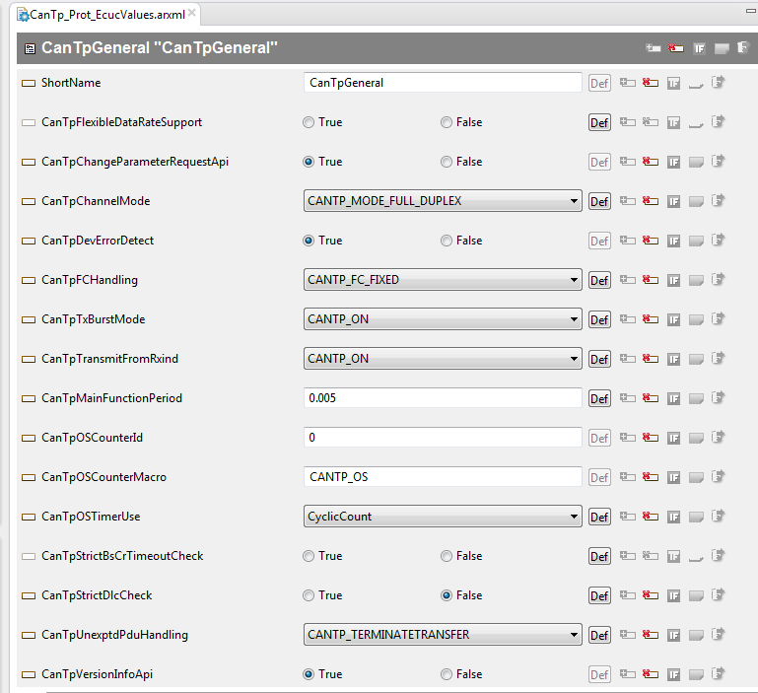
CanTp General - Container View (BCT)
DCOM CanTp Training
Confidential | CDG-SMT/ESB3 Daniel Hahn | 04.10.2016 | © Robert Bosch GmbH 2007. All rights reserved, also regarding any disposal, exploitation, reproduction, editing, distribution, as well as in the event of applications for industrial property rights.

Slide 38
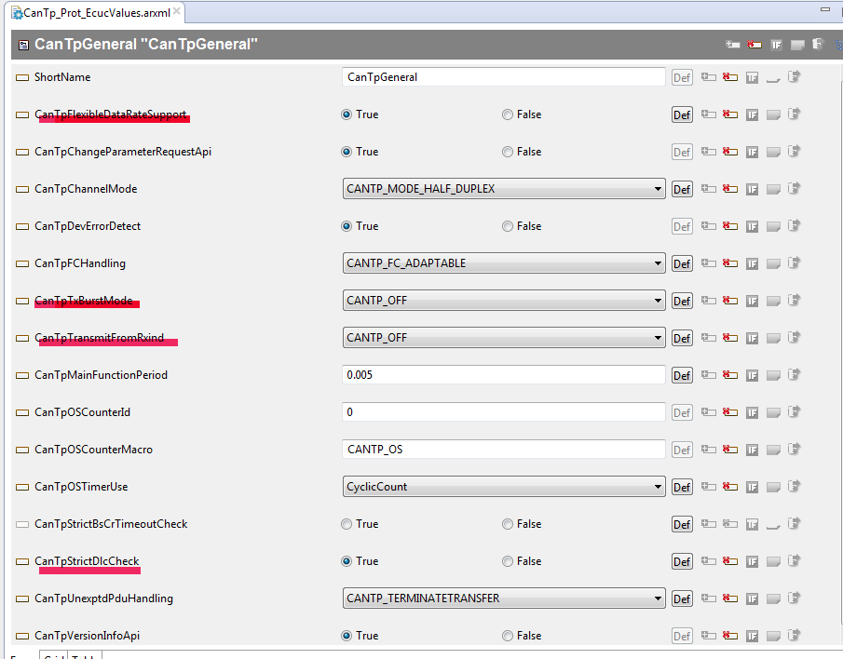
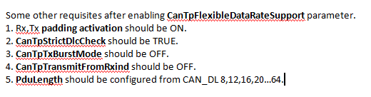
CanTp General - Container View (BCT) with CanFD
DCOM CanTp Training
Confidential | CDG-SMT/ESB3 Daniel Hahn | 04.10.2016 | © Robert Bosch GmbH 2007. All rights reserved, also regarding any disposal, exploitation, reproduction, editing, distribution, as well as in the event of applications for industrial property rights.

Slide 39
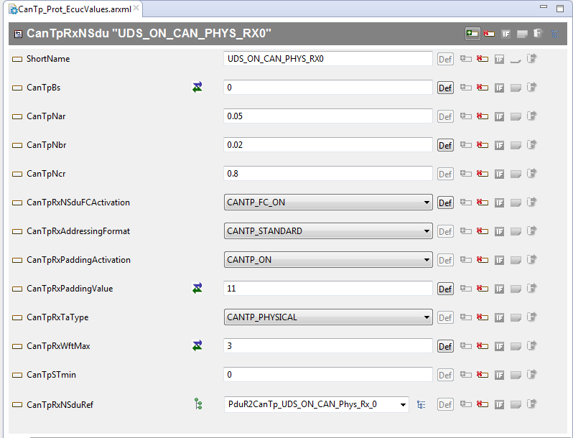
CanTp Rx N Sdu - Container View (BCT)
DCOM CanTp Training
Confidential | CDG-SMT/ESB3 Daniel Hahn | 04.10.2016 | © Robert Bosch GmbH 2007. All rights reserved, also regarding any disposal, exploitation, reproduction, editing, distribution, as well as in the event of applications for industrial property rights.

Slide 40
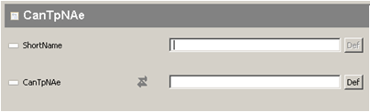
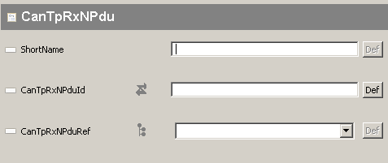
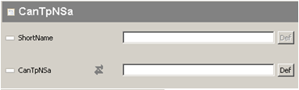
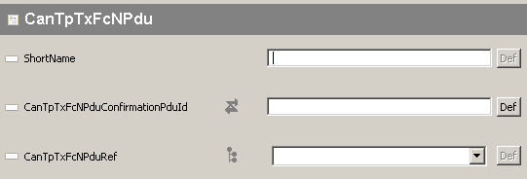
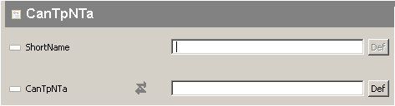
CanTp Rx N Sdu – Sub Container View (BCT)
DCOM CanTp Training
Confidential | CDG-SMT/ESB3 Daniel Hahn | 04.10.2016 | © Robert Bosch GmbH 2007. All rights reserved, also regarding any disposal, exploitation, reproduction, editing, distribution, as well as in the event of applications for industrial property rights.

Slide 41
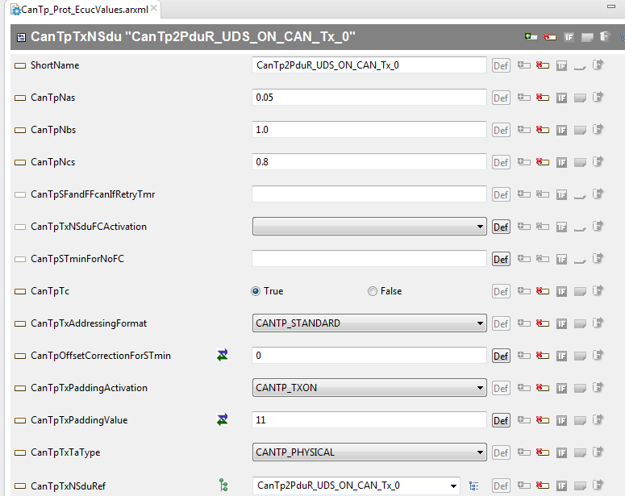
CanTp Tx N Sdu - Container View (BCT)
DCOM CanTp Training
Confidential | CDG-SMT/ESB3 Daniel Hahn | 04.10.2016 | © Robert Bosch GmbH 2007. All rights reserved, also regarding any disposal, exploitation, reproduction, editing, distribution, as well as in the event of applications for industrial property rights.

Slide 42
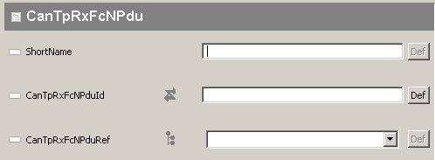
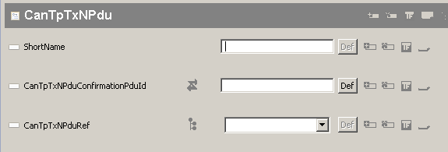
CanTp Tx N Sdu – Sub Container View (BCT)
DCOM CanTp Training
Confidential | CDG-SMT/ESB3 Daniel Hahn | 04.10.2016 | © Robert Bosch GmbH 2007. All rights reserved, also regarding any disposal, exploitation, reproduction, editing, distribution, as well as in the event of applications for industrial property rights.

Slide 43

DCOM CanTp Training
Confidential | RBEI/EAR2 - Ramachandran V | 04.10.2016 | © Robert Bosch GmbH 2007. All rights reserved, also regarding any disposal, exploitation, reproduction, editing, distribution, as well as in the event of applications for industrial property rights.

Slide 44

DCOM CanTp Training
Confidential | RBEI/EAR2 - Ramachandran V | 04.10.2016 | © Robert Bosch GmbH 2007. All rights reserved, also regarding any disposal, exploitation, reproduction, editing, distribution, as well as in the event of applications for industrial property rights.

